Slide 1
令和３年度 システム生命科学府
ネットワーク利用ガイダンス
令和3年4月6日(火)

Slide 2
配布資料について
5．情報システムに関するお知らせ

Slide 3
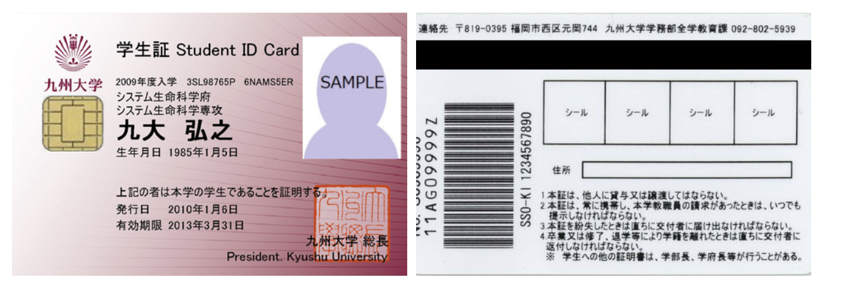
SSO-KIDについて(1)
九州大学全学共通ID:SSO-KID
九州大学全体での共通アカウント
アクティベートに必要な情報
アクティベーションコード(有効化コード)
SSO-KID
表
裏

Slide 4
SSO-KIDのアクティベーション1
配付資料に記載のWebページに従いアカウントを設定
赤枠内をクリックし、アクティベーション説明ページへ

Slide 5
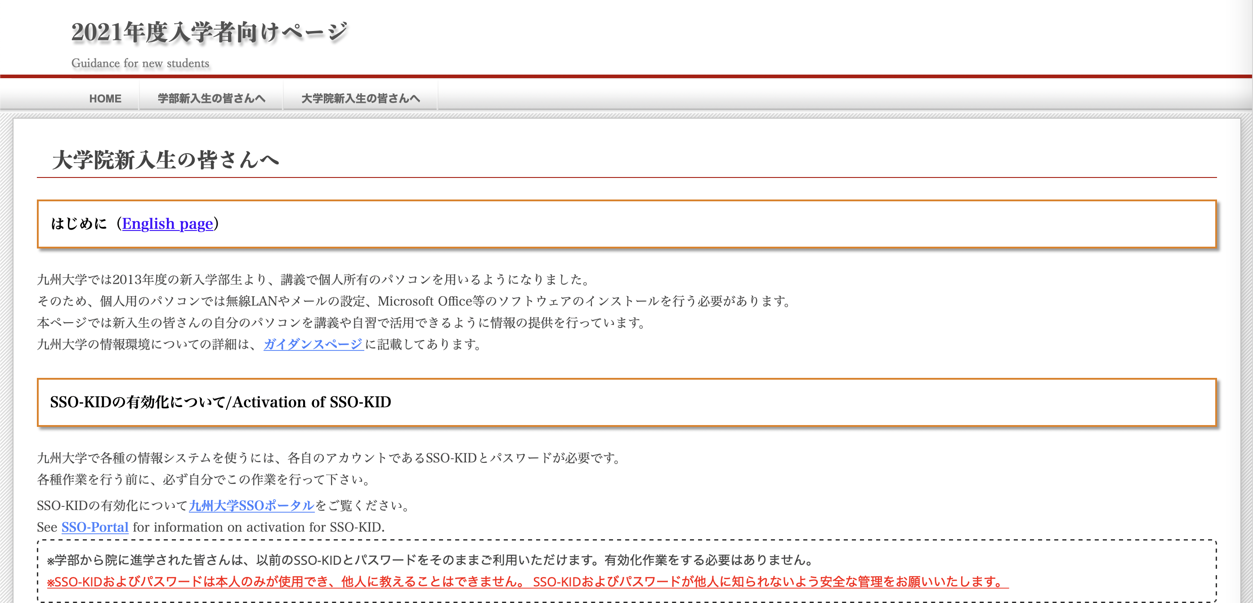
SSO-KIDのアクティベーション2
赤枠内の「九州大学SSOポータル」をクリックすると
SSO-KIDのポータルサイトに移動します。
サイト内のアクティベーション方法の説明をご覧ください。

Slide 6
SSO-KIDによる提供サービスについて
学生基本メール
学籍番号@s.kyushu-u.ac.jpのメールアドレスが与えられます。
全学、学府内の重要な連絡がこのアドレスに対して行われます。
定期的に確認をお願いします
大学無線LAN（edunet, kitenet)
学内のほとんどの場所で利用可能です（全てではありません）。
スマートフォンも利用可能です。
各種ソフトウェアの提供
ウイルス対策ソフト、オフィスソフトウェア等が利用できます。
アクティベーションをしないと、これらのサービスが使えません。

Slide 7
学生基本メールについて
・全学、学府内の連絡がこのアドレスに対して行われます。
・メールソフトでメールを受け取ることも、Web ブラウザ上から
メールを確認することもできます。
・個人で取得されたメールアドレスに転送することもできます。
・設定方法、利用方法については以下のアドレスを参照してください。
（情報システムに関するお知らせ内に記載）
https://ci.iii.kyushu-u.ac.jp/m/

Slide 8
学生基本メールについて（注意点）
携帯キャリアへの転送は添付ファイル等で届かない場合があります。
Gmail等のPCで確認するメールアドレスに転送設定を行ってください
Gmail等に転送を行った場合、迷惑メールフィルタが適用される場合があります。
@s.kyushu-u.ac.jpをホワイトリストに追加してください
アクティベーション前にメールアカウント自体は作成されています
既にメールが届いている場合があるので一度はWebメール等で確認してください

Slide 9
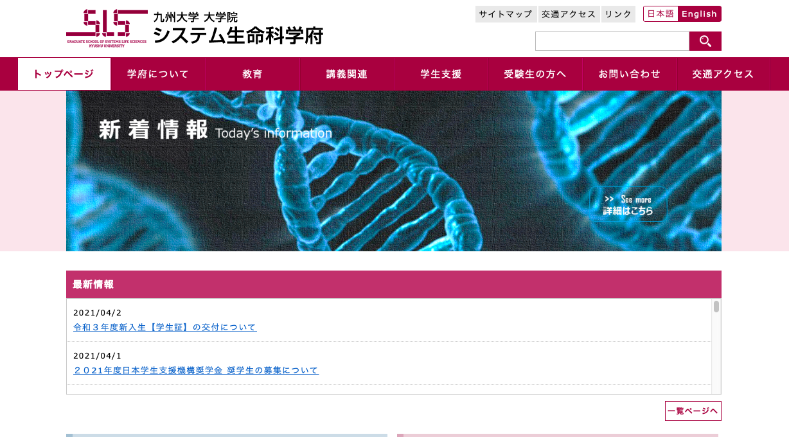
システム生命科学府のHPについて
講義情報等の重要な情報がシステム生命科学府のホームページに掲載されます。
http://www.sls.kyushu-u.ac.jp/

Slide 10
オンライン講義について
ご自身のPCからWeb会議システム(Microsoft Teams, Zoom, etc…)に接続します。（講義に使用するシステム、会議室ID、パスワードなどは事前に皆さんにお伝えします。）
利用するWeb会議システムのインストールや、知らされた会議室のID、パスワードを用いて講義室に入室してください。
その他、講義に関する変更事項などは、事務を通して皆さんにおしらせします。定期的な確認をお願いします。

Slide 11
ご静聴、ありがとうございました。

Slide 12
Guidance of Network Usage for Systems Life Sciences
Spring,2021
Notes:
Welcome to Kyushu University, and welcome to System Life Service graduated school.
I am Yuichi Ayukawa. I support Remote Videoconferencing system.
From today, You are Kyushu University Student.
In kyushu University, Student use some Information system for free.
But when you use these systems, you need to ready for using it.
Now, I explain how to do before you use these systems.
I think you would feel tired, but please listen carefully.
I explain according to these sheet.
Today I tell you “Guidance of Network Usage”.

Slide 13
Materials
･Announcement about Information system for Newcomers
･How to activate your SSO-KID
･Website notification
Notes:
This is Materials for today’s guidance.
At first, I explain Information Systems for newcomers.
Secondly, I explain how to activate your SSO-KID.
SSO-KID uses some information system.
But before using SSO-KID, you have to activate it.
In this time you will make your password.
Information Infrastracture Initiative (This group provide public information system for kyushu University Member (Student, Officer, and so on )) provide guide for activating SSO-KID.
Today I explain how to access this guide.
And this term I explain other Information System, Kyushu university Primary mail System, School Wi-Fi Network, Software Providing and so on…
At last I explain Website notification. In this term I tell you Remote Videoconferencing System. This system need your help when you attend lecture.
O.K. I tell you accuracy.

Slide 14
About SSO-KID
Single Sign-On Kyushu university ID : SSO-KID
Student ID
Kyushu University Common ID
Activation must be needed before you use services such like;
・kitenet, edunet (School Wi-Fi network)
・Kyu(Q)shu U. Primary Mail Service
Notes:
In Kyushu University, Student have 2 IDs.
One is Student ID, I think you will write down or type again and again.
It doesn’t need activate.
The Other is SSO-KID, It is an abbreviation for Single Sign-On kyushu unuversity ID.
It needs activate.
It is Kyushu University Common ID.
Before you use Kitenet, edunet(these service are School Wi-Fi network systems), and Kyushu University Primary Mail Service, you must activate SSO-KID

Slide 15
About SSO-KID
Importtant Information for Activate SSO-KID
Important Information for Activate SSO-KID
Student ID
SSO-KID
Registration Code
Notes:
I wanna ask you, Do you have a Kyushu University Identification card?
I think when you entered this room, Officer gave you this ID card.
Everybody have it, Don’t you? Okay.
In this sheet, this picture shows Student ID card.
If you are sure, Please listen my word, as watching your id card.
First, Please look your id card’s surface.
You will see the string “Student ID card”, and next line some information note on it.
On the left side, year you entered Kyushu University, and on the center it notes student number.
you will see 9 strings (1 numeric, 2 Alphabet, 5 numeric, and 1 Alphabet strings )
Kyushu University student will see these strings again and again.
On the right side, you will see Large Alphabet and numeric random strings. It is Registry code. you use it when you activate SSO-KID.
Next, Please turn back your ID card.
you can see Barcode.
next to Barcode 10 numeric strings you can see.
It is your SSO-KID.
When you activate your SSO-KID, you would use Student ID, Registration code, and SSO-KID.
Please remember where these strings is on your student ID card.
Before you use these services, you must activate SSO-KID.
In next Page, I explain where get information how to activate SSO-KID accuracy.

Slide 16
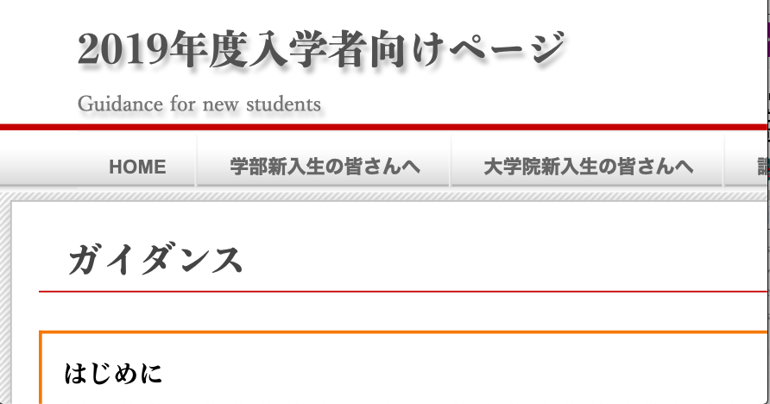
SSO-KID Account Activation 1
Visit the website on the material to refer a guidance.
Click the mark in red to display the guidance for activation.
Notes:
Now you might get a paper important information in using Information Services written in.
this paper title is “Announcement about Information systems for Newcomers ”. Do you have it?
In this paper, it tells URL for activating your SSO-KID.
If you access this URL on your any device (PC, Mac, iPhone, iPad and so on…), you would see the page like this.
When you visit this page, please click the mark in red to display.
After you click the mark in red, you will go the page for graduated school newcomers.

Slide 17
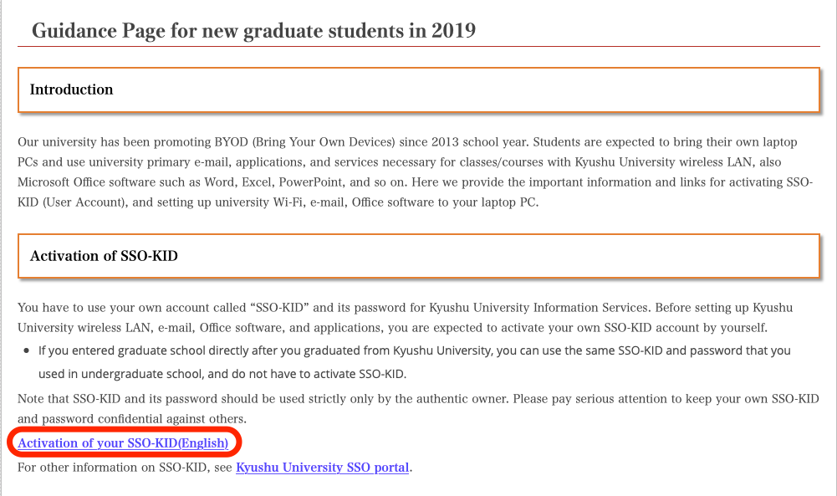
SSO-KID Account Activation 2
Click the mark in red and follow the guidance displayed to activate your account.
Notes:
This picture shows the page from graduated school newcomers.
On subject “Activation of SSO-KID”, you will see the link “Activation of your SSO-KID”
In this picture this link is marked in red.
Please click this link, So you will access the guidance.
And then follow the guidance displayed to activate your account.

Slide 18
Provided Services
Kyu(Q)shu U. Primary Mail Service
A primary mail address based on the student ID with the e-mail domain of s.kyushu-u.ac.jp
(Student ID)@s.kyushu-u.ac.jp
is provided to each student.
School Wi-Fi network (kitenet, edunet)
You can access the school Wi-Fi almost everywhere inside campus. Some information, such like lecture materials, can be seen only through the school network.
Software providing
Anti-virus software, Office software or else can be downloaded for free.
Notes:
In Kyushu University, Student provide these services.
At first, about Kyushu University primary mail service.
Now you have primary mail addresss in kyushu university.
this address based on your studentID withb the e-mail domain of s.kyushu-u.ac.jp
this adress is provided to each student.
Next, School Wi-Fi network is provided to each student.
At this University, you will often see “kitenet” or “edunet”.
these are School Wi-Fi network’s name.
you can access the school Wi-Fi Network (“Kitenet” and “edunet”).
this network almost everuwhere inside campus.
Some information, such like lecture materials, can be seen only through the school network.
Please be careful.
At Last, Some software is provided to student for free.
For example, Anti-virus software, Microsoft Office software or else can be download for free.

Slide 19
Kyu(Q)shu U. Primary Mail Service
Setup and Usage
http://www.m.kyushu-u.ac.jp/s/
･Every important notice will be informed you through this address.
Regularly mail box checking is required
･Mail forwarding system is available. You can transfer mail to your own email address.
Attention
Massages can be reached your account even before activation.
Please check your mail box as soon as you will have done the setting up.
Notes:
Before you use Kyushu University Primary Mail Service, you have to configure.
In this URL, the guidance how to setup and use this mail service is
When you use this mail service, please check your mail box Regularly.
Because every important notice will be informed you through this address.
If you have another mail address, and you want to mainly use it, you can use Mail forwarding system.
But I wanna pay attention this sentence.
Even before activate your SSO-KID, Message box is exist and able to reach Message.
After setting up your mail, please check your mailbox as soon as possible.
Next I tell you Mail forwarding system in more detail.

Slide 20
Mail Forwarding System
･Emails with large storage will not be reached to addresses with the domain of mobile phone operator. When you use forwarding system, please forward to e-mail service without providing by phone company.
･Add the domain“@s.kyushu-u.ac.jp” to the white list.
･After the setting, you MUST check E-mail reachability by sending an E-mail to your default address.
･Messages reached before setting up are not forwarded to the set address. You will need to move essential messages to your set address yourself, if it is necessary.
Notes:
When you use forwarding system, When you use "Mail Forwarding System, you will regist your private e-mail address.
But please do not registry e-mail address providing by mobile phone company.
If e-mails with large storage send to your mail address with the domain of mobile phone provider, it would not be get this mail.
Please forward to e-mail without providing by phone company.
In your main mail forwarded from Kyushu University Mail, Please add the domain "@s.kyushu-u.ac.jp" to the white list.
After setup Mail Forwarding system, you MUST check E-mail reachability by sending an E-mail to your default address.
Messages reached before setting up are not forwarded to the set address. If it is necessary, youwill need to move essential messages to your set address by yourself.
Please be careful.
Because, in rare cases, mail from Kyushu University is judged as spam mail in some cases.

Slide 21
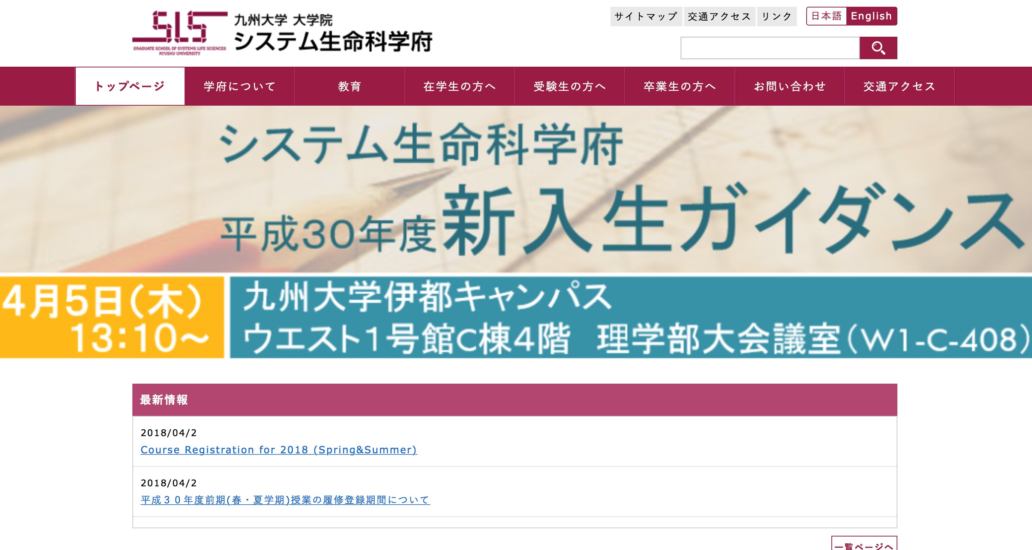
Systems Life Sciences Website
Lecture information including cancellation, materials and special lecture offering are announced on the website.
http://www.sls.kyushu-u.ac.jp/
Notes:
This picture shows graduated school for system life science's sight.
In this sight anounced important information.
For example, Lecture cancellation,Lecture materials, special Lecture offering and so on.
If change lecture room because of some accident, this sight announced change lecture room.
This sight announced important information, please check regularly.

